Slide 1
Legislation Update
Bob Rapoza
March 15, 2023

Slide 2
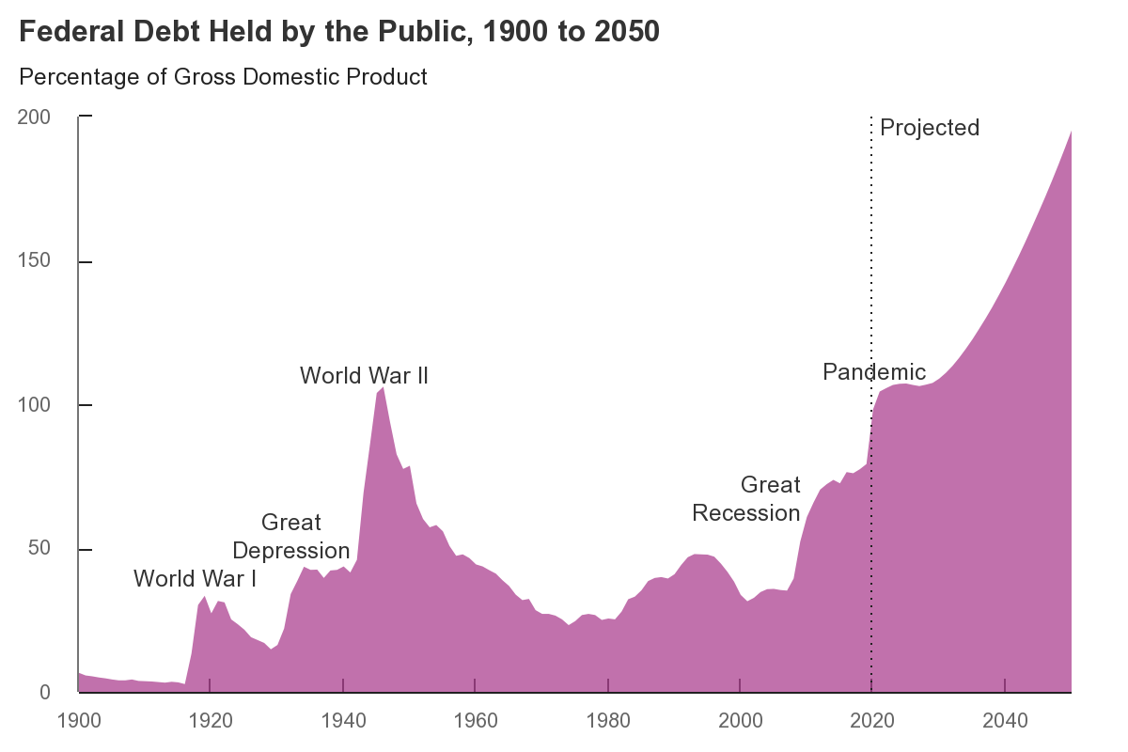

Slide 3
Total Federal Discretionary Spending FY 23 (enacted)
Defense -- $858 Billion
Domestic - $734 Billion
Total $1.592 Trillion
Reduction to FY 22 level - $130 billion

Slide 4
Changes in House Appropriations
Kay Granger (R-TX) Chair, Full Committee
Steve Womack (R-AR)Andy Harris (R-MD) Chair, Financial Services General Government
Steny Hoyer (D-MD), Ranking Member
Financial Services General Government

Slide 5
Changes in Senate Appropriations
Patty Murray (D-WA) Chair, Full Committee
Susan Collins (R-ME) Ranking Member, Full Committee
Bill Hagerty (R-TN) Ranking Member, Financial Services General Government

Slide 6
Details on CDFI Fund FY 24 Budget
$341 million: + $17 million above FY 23
$201.179 million for grants for Financial Assistance (FA) and Technical Assistance (TA), which builds the capacity of CDFIs to leverage other private and public resources that finance a variety of small businesses, affordable housing, and community facilities, CDFI assistance to persons with disabilities, areas of persistent poverty, and the Economic Mobility Corps;
$25 million for Native Initiatives program;
$24 million for Healthy Food Financing;
$35 million for the Bank Enterprise Award program;
$9 million for the Small Dollar Loan Fund program;
$37.299 million for Administration and Research;
$10 million for credit subsidy for the bond guarantee program to support: $500 million program level

Slide 7
Important Dates
March 16 – Closing of Bipartisan House Letter on CDFI Fund appropriations
March 24 -- Deadline for Member Requests to House Financial Services General Government Appropriations https://appropriations.house.gov/subcommittees/financial-services-and-general-government-118th-congress
March 31- Deadline for Member Requests to Senate Financial Services General Government Appropriations FY2024 Appropriations Requests General Guidance.pdf (senate.gov)
April 17( or later) – House marks and debates FY 24 Budget Resolution
May –June – House marks and considers FY 24 Appropriations bills
July –August – agreement, or not, on debt limit extension

Slide 8
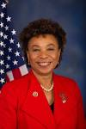
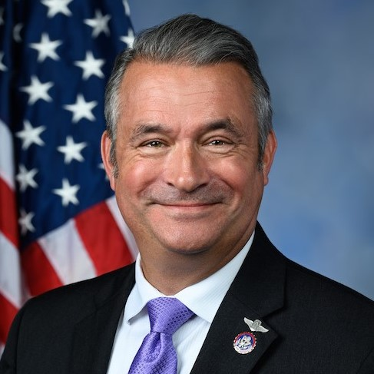
House Appropriations Letter
Sponsors:
Rep. Barbara Lee (D-CA)
Rep. Don Bacon (R-NE)

Slide 9
House Dear Colleague
Updated: Support the Community Development Financial Institutions (CDFI) Fund in FY24
Deadline: Thursday, March 16, 2023
Cosign Here
View Letter Here
Dear Colleague,
Please join us in sending a letter to the Financial Services and General Government Appropriations Subcommittee requesting an appropriation of at least $341 million for the Community Development Financial Institutions (CDFI) Fund. This is the same amount requested in the Fiscal Year 2024 Treasury Department budget. Access to affordable credit is a pressing issue in many underserved rural, urban, and Native American, Alaska Native, and Native Hawaiian communities.
The CDFI Fund provides resources for a range of innovative and effective programs through this appropriation that enable CDFIs to address the needs of their target markets. CDFI Fund programs include Financial Assistance (FA) and Technical Assistance (TA) awards to small and emerging CDFIs, established CDFIs, the Native American CDFI Assistance (NACA) Program aimed at increasing the number and capacity of CDFIs serving Native communities, and CDFIs serving persons with disabilities. In addition, the program also includes the Healthy Food Financing Initiative (HFFI) to expand financing for healthy food options in underserved urban and rural communities; the Bank Enterprise Awards (BEA) program providing monetary awards to FDIC-insured banks that invest in low-income communities and CDFIs. The FY23 appropriations also provided funding for the Small Dollar Loan Program and Economic Mobility Corps.
The CDFI Fund’s mission is to expand the capacity of CDFIs to provide credit, capital, and financial services to underserved populations and communities across the country. Housed within the Department of the Treasury, the CDFI Fund spurs investments in local and often underserved communities in rural and urban areas and Native American, Alaska Native, and Native Hawaiian communities by fostering the creation and expansion of CDFIs - private sector financial institutions that specialize in providing affordable credit, creating jobs, and revitalizing neighborhoods.
Cosign here to join us in supporting the funding level of $341 million for the CDFI Fund in FY24. If you have questions, please contact Erika Ninoyu with Rep. Barbara Lee at Erika.Ninoyu@mail.house.gov or Valerie Foy with Rep. Don Bacon at Valerie.Foy@mail.house.gov.
Sincerely,
Barbara Lee Don Bacon
Member of Congress Member of Congress

Slide 10
State Fact Sheets

