Slide 2
How the Microloan Program Works
SBA
SBA Lends $ to Intermediary Lender
Intermediary Lender
Lends $ to Microbusinesses
Microbusiness
SBA Provides grants $ to Intermediary Lender to help offset cost of providing Training and Technical Assistance (TA)
Provides Training and TA to microbusinesses
  Intermediary Lender repays SBA
  Borrows Funds for Business Growth
  Microbusiness repays Loan to Intermediary Lender

Slide 3
Microloan Program Deadlines
New Intermediary Application
No Deadline
TA Grant – FY2023 (Existing Intermediaries Only)
March 30, 2023
PRIME Grant (Competitive)
Applications April 1 – April 30, 2023

Slide 4
SBA Microloan Program
Example of Successful Microloan Intermediary
Lender Location
Midwest
FY23 Loan Volume
599 Microloans $3,660,700 – Average Loan - $6,548
Demographics
Woman-Owned – 61%
Jobs Created/Retained
Created – 280
Start-Ups – 18%
Black/African American – 23%
Retained - 978
26,000 hours of training provided
TA Hours delivered FY22

Slide 5


Ladder of Opportunities
Lender Match
Office of Capital Access
Entrepreneur Education
7a Loan program
Intermediaries
SBA Express
Women’s Bus. Ctr.
SCORE
504 Loan Program
VBOC
Community Advantage
SBDC
Microloan
Surety Bond
Government Contracting

Slide 6


Questions and Point of Contact
Daniel Upham
Chief, Microenterprise Development Division
Daniel.Upham@sba.gov
Phone 202-205-7001

Slide 7

U.S. Treasury SSBCI Capital Programs
March 15, 2023
This presentation provides background on SSBCI capital programs. Please refer to the Capital Program Policy Guidelines and other guidance published on Treasury’s website at https://home.treasury.gov/policy-issues/small-business-programs/state-small-business-credit-initiative-ssbci.
Notes:
Introduce myself – Outreach Manager for Southeast region and part of Caribbean territories

Slide 8
SSBCI Topics for Today
Brief Recap of SSBCI Program Structure and Goals
CDFI Involvement in the First Iteration of SSBCI
Considerations for CDFI Involvement Going Forward
Where You Can Go to Learn More

Slide 9
Brief Recap of SSBCI (1 of 2): Program Genesis
Subtitle C of Title III of the American Rescue Plan Act of 2021 (ARPA) reauthorizes and amends the Small Business Jobs Act (SBJA) of 2010, which established the State Small Business Credit Initiative (SSBCI) Program.
ARPA provides a combined $10 billion in funding to SSBCI to assist states, the District of Columbia, territories, and Tribal governments (Eligible Jurisdictions) in addressing the economic fallout of the pandemic and lay the foundation for a strong and equitable recovery by providing direct support to jurisdictions for programs that increase access to capital for small businesses.
The $10 billion in SSBCI funding includes the following allocations:
$500 million to Tribal Governments to support small businesses
$1.5 billion to support business enterprises owned and controlled by socially and economically disadvantaged individuals (SEDI-Owned Businesses)
$1 billion for an incentive allocation to jurisdictions that demonstrate robust support for SEDI-owned businesses.
$500 million to support very small businesses
$500 million for technical assistance

Slide 10
Brief Recap of SSBCI (2 of 2): Program Overview
SSBCI financing programs provide targeted support to small businesses through leveraging jurisdiction-specific knowledge of local business needs, leveraging responsible local financing partners, and complementing existing state and local programs.
Small business financing barriers
SSBCI Provides…
Eligible jurisdictions direct capital…
  Lack of collateral
  Short credit or operating history
  Loan requests that are for amounts that are too small for many private lenders
  COVID-19 impacts on revenues and supply chain disruptions
  Located in an underserved community or part of group historically disadvantaged from accessing capital
  Seeking scarce early-stage equity capital
  …jurisdictions funding for
  …within broad federal parameters for:
  Small business financing programs, which include capital access programs, loan participations, loan guarantees, collateral support, and VC programs.
  Technical assistance in the form of legal, accounting, and financial advisory services to certain small businesses applying for support under SSBCI capital programs and other government programs.
  Other Credit Support Programs (OCSPs)
  Small businesses receiving support must have no more than 750 employees, with jurisdictions targeting an average size of 500 employees or less
  Each transaction can’t exceed $20M and the OCSP must target transactions with an average size of $5M or less
  Capital Access Programs
  Small businesses receiving support must have no more than 500 employees
  Each loan cannot exceed $5M
  Lenders/investors must have a meaningful amount of their own capital at risk and the eligible jurisdiction must demonstrate a reasonable expectation of 10:1 leverage*.
*10:1 leverage means that a jurisdiction’s programs, considered together, have the ability to generate small business lending and investment at least 10 times the federal contribution amount

Slide 11
CDFI Activity in the First Iteration of SSBCI
SSBCI Activity by the Numbers:
10k+
SSBCI CDFI transactions under the first iteration of SSBCI in the 2010s
$638M+
Loaned to eligible small businesses by CDFIs during the first iteration of SSBCI
25+
CDFI institutions with over 35 SSBCI transactions, with average SSBCI transaction sizes ranging from $2.2k - $15.7M

Slide 12
Consideration for CDFIs in this Iteration of SSBCI
1
Varied Program Landscape across Jurisdictions
2
Jurisdiction SEDI Targets and Incentives
3
1:1 Private Capital Match Sources
4
Capital Infusion from Treasury’s ECIP Program

Slide 13
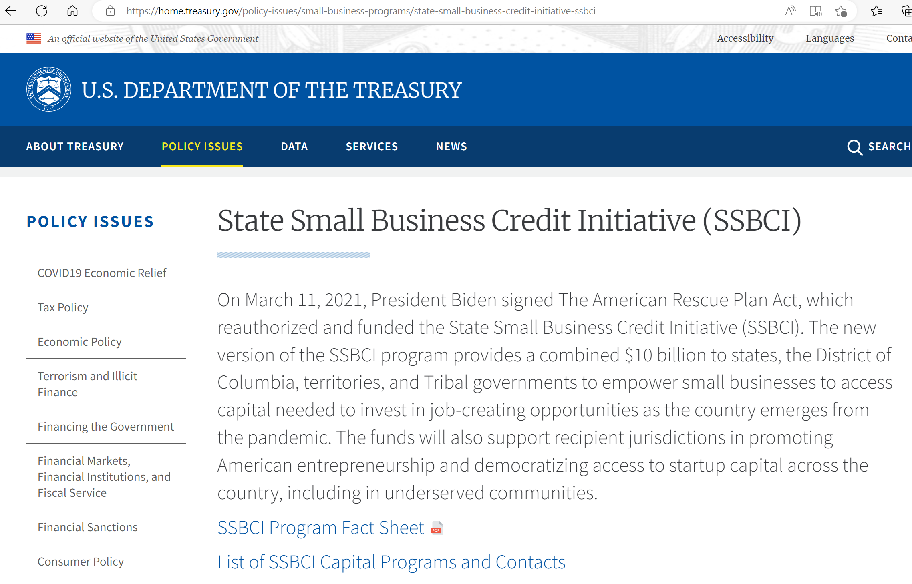
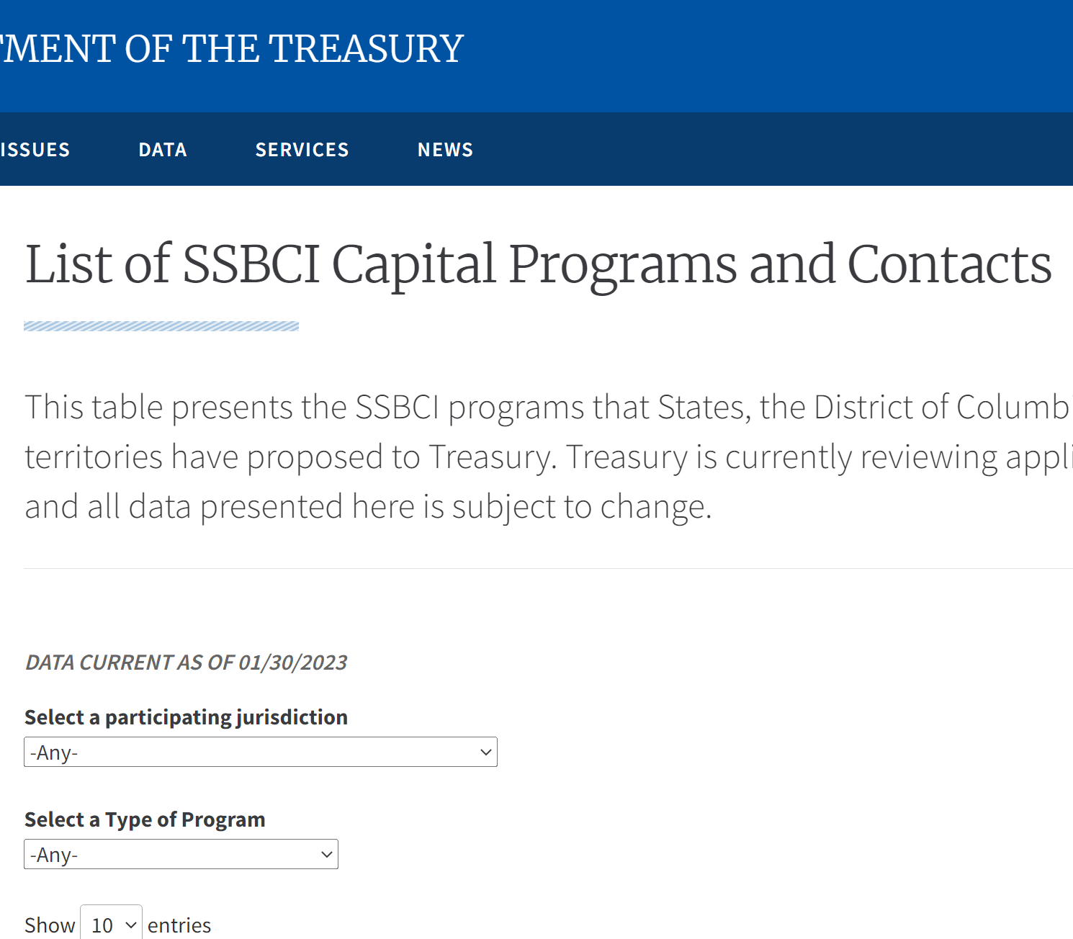
Where to Learn More – Treasury.gov/SSBCI
Also See:
  Capital Program Policy Guidelines
  Jurisdiction Program Approval Press Releases
  Best Practice Documents
  Historical Program Reports

Slide 14
Questions?

Slide 15


2023 CDFI Coalition Institute
Rural Business-Cooperative Service
Jimmy Dahman | Chief of Staff

Slide 16


U.S. Department of Agriculture

Slide 17

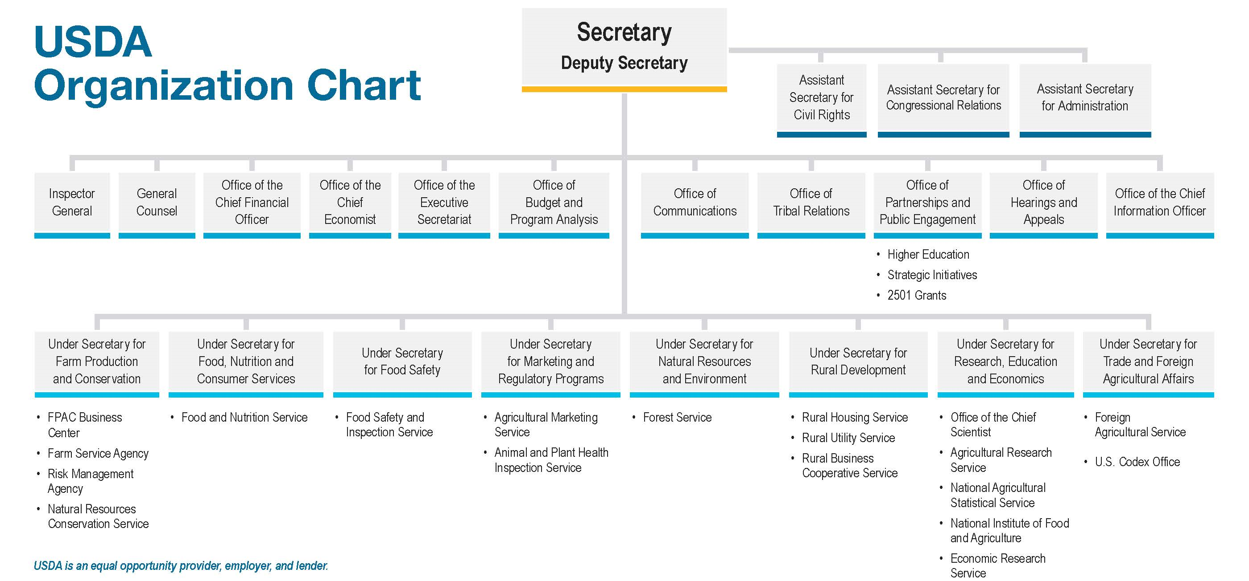
USDA Organization Chart
UPDATED 10/19/21 This organization chart displays the names of USDA offices, agencies, and mission areas. Each office, agency, and mission area is placed within a cell connected by lines to show the structure and hierarchy for which they fall under.
Notes:
Rural Development is central to both the mission and vision of USDA.

Slide 18
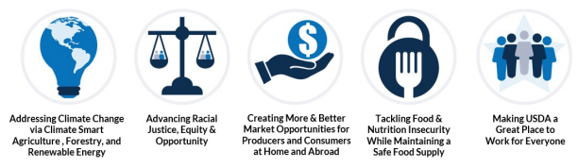

USDA Cross-Cutting Priorities
Addressing climate change via climate smart agriculture, forestry,
& renewable energy
Tackling food & nutrition insecurity while maintaining
a safe food supply
Creating more & better market opportunities for producers and consumers at home and abroad
Advancing racial justice, equity, & opportunity
Making USDA a great place to work for everyone
https://www.usda.gov/sites/default/files/documents/usda-fy-2022-2026-strategic-plan.pdf

Slide 19
Rural Development

Slide 20
Mission Area: Rural Development (RD)
USDA
Rural Development (RD)
“Together, America Prospers”
Rural Business-Cooperative Service (RBCS)
Rural Housing Service
(RHS)
Rural Utilities Service
(RUS)
Rural Development administers over 40 programs and supports rural communities with loan and grant investments of ~$50 billion annually. The current RD portfolio of investments exceeds ~$220 billion.
https://rd.usda.gov/about-rd/state-offices
Notes:
While government may be through of as a single entity, there are often numerous departments, agencies, and offices. It is critical to work across these units to be successful.
For example
OneRD streamlines loan guarantees for us and the lenders we work with.
Solar financing occurs in two agencies and can benefit a third. We are working together to align efforts in that sector to close gaps, eliminate overlap, and help us meet our climate goals.

Slide 21
RD Agencies
RUS
RHS
RBCS
Rural Utilities Service
Rural Housing Service
Rural Business-Cooperative Service
RUS provides infrastructure or infrastructure improvements to rural communities.
Clean and reliable energy production
Affordable and sanitary water & environmental
Expanding rural broadband
RHS offers programs to build or improve housing and essential community facilities in rural areas.
Supporting affordable single family home ownership, multi-family housing, and farm labor housing
Supporting community facilities like healthcare, education, childcare and other public owned facilities
RBCS offers programs to help businesses grow as well as job training in rural areas.
Supporting rural small businesses and entrepreneurs
Supporting co-operatively owned enterprises
Supporting local food systems and clean energy development
https://www.rd.usda.gov/about-rd/agencies

Slide 22
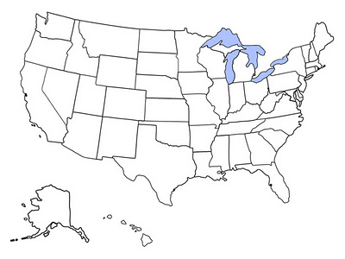
RD Geographic Breakdown
47 State Offices
400 Area Offices
https://rd.usda.gov/about-rd/state-offices
Notes:
Rural development operates through state offices. As I’ll mention later, these state offices provide numerous opportunities for local partnerships that help us tailor program delivery to diverse rural areas.

Slide 23
Rural Business-Cooperative Service Programs

Slide 24
REAP | Systems, Equipment, Improvements
The Rural Energy for America Program (REAP) provides guaranteed loan financing and grant funding to agricultural producers and rural small businesses for renewable energy systems or to make energy efficiency improvements. Agricultural producers may also apply for new energy efficient equipment and new system loans for agricultural production and processing.
Available Funding
Grants can cover up to 40% of total eligible project costs (from 25% pre-IRA)
Loan Guarantees (up to 80% guarantee) on loans up to $25 million and can cover up to 75% of total eligible project costs
Combined grant and loan guarantee funding can cover up to 75% of total eligible project costs

Slide 25
REAP | Inflation Reduction Act (IRA) Funding
REAP was funded with an additional $2.02 billion dollars over the next decade to invest in over 45,000 farms and small businesses.
Investment
$1.7 billion for REAP
$304 million for underutilized technologies and technical assistance
Universities, state and local governments, tribal entities, and rural electric cooperatives can apply for the grant to provide energy audits and technical assistance
to rural small businesses and agricultural producers.

Slide 26
Rural Microentrepreneur Assistance Program (RMAP)
RMAP provides loans and grants to Microenterprise Development Organizations (MDOs) to help microenterprises startup and growth through a Rural Microloan Revolving Fund and to provide training and technical assistance to microloan borrowers and microentrepreneurs. Nonprofits, federally-recognized tribes, and institutions of higher education are eligible to be MDOs. MDOs are not required to be located in a rural area, but the microentrepreneurs they lend to must be in rural areas.
Grants up to $205,000 annually – to provide TA to rural microentrepreneurs or microenterprises
Loans of $50,000 to $500,000 – to establish a Rural Microloan Revolving Fund managed by an MDO
Loan Terms | Terms on Loans to Microenterprise | Eligible Use of Funds
Maximum term is 20 years Two-year payment deferral Must establish a loan loss reserve fund | Up to $50,000 Fixed interest rate Limited to 75% of project cost | Working capital Debt refinancing Purchasing equipment & supplies Improving real estate
https://www.rd.usda.gov/programs-services/business-programs/rural-microentrepreneur-assistance-program

Slide 27
Intermediary Relending Program (IRP)
IRP provides 1% low-interest rates (max term of 30 years) to local lenders or “intermediaries” that re-lend to businesses to improve economic conditions and create jobs in rural communities. Eligible intermediaries include nonprofits and cooperatives, federally-recognized Tribes, and public agencies.
Maximum funding for intermediaries: $1 million
Maximum loan amount for ultimate recipients: $400,000 or 50% of the loan to the intermediary lender
Must be located in an eligible rural area
Website: https://www.rd.usda.gov/programs-services/business-programs/intermediary-relending-program

Slide 28
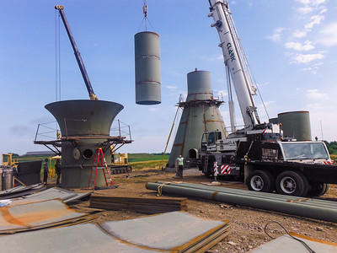
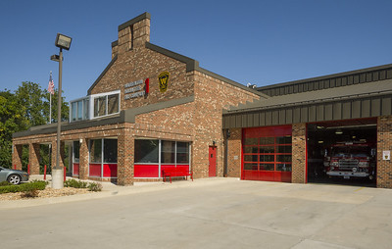
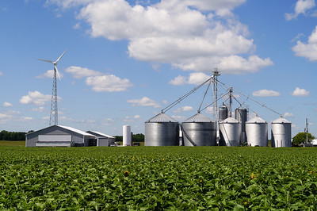
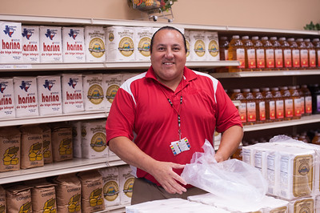
OneRD Guarantee Loan Initiative
What is the OneRD Guarantee Loan Initiative?
A standard policy and process for RD guaranteed loan making in four programs:
  Water and Waste (WWD)
  Community Facilities (CF)
  Business and Industry (B&I)
  Rural Energy for America (REAP)
  Food Supply Chain (FSC)
https://www.rd.usda.gov/onerdguarantee

Slide 29
Business & Industry (B&I) Guaranteed Loans
B&I offers 80% loan guarantees to lenders for their qualified loans up to $25 million to businesses in rural areas. The program is administered through your local Rural Development office and enables lenders to provide affordable financing for rural businesses.
Lender registration - https://www.rd.usda.gov/onerdguarantee
Training for nonregulated lenders - https://www.youtube.com/watch?v=3AWJiCDY-Cs
Eligible Uses:
Business conversion, enlargement, repair, modernization, or development
The purchase and development of land, buildings, and associated infrastructure for commercial or industrial properties
The purchase and installation of machinery and equipment, supplies, or inventory.
Debt refinancing when such refinancing improves cash flow and creates jobs.
Business acquisition when the loan will maintain business operations and create or save jobs.
https://www.rd.usda.gov/programs-services/business-programs/business-industry-loan-guarantees

Slide 30
Food Supply Chain (FSC) Guaranteed Loans
The FSC Program uses $100 million in funding from the American Rescue Plan to guarantee loans up to ~$1.4 billion in order to provide support to middle of the food supply chain businesses that handle food aggregation, processing, manufacturing, storage, transportation, wholesaling, and distribution.
$40 million maximum loan size (no minimum)
Up to a 90% guarantee
No geographic restrictions
Processed through the OneRD Guarantee Loan Initiative
Website: https://www.rd.usda.gov/foodsupplychainloans

Slide 31

Contact Information
Assistance under USDA Rural Development programs is available to applicants in areas designated
as “rural.” Under law, the definition of “rural area” is different for each program.
Contact your local USDA Rural Development office for more information.
https://rd.usda.gov/about-rd/state-offices
Or go to: www.rd.usda.gov
Or call 1 (800) 670-6553 (toll free)
Jimmy Dahman – Chief of Staff
Rural Business Cooperative Service
jimmy.dahman@usda.gov
(202) 961-0870
USDA is an equal opportunity provider, employer, and lender.

Slide 32
Thank you!
USDA is an equal opportunity provider, employer, and lender.

Slide 33

Community Economic Development
An Overview
Lynda Perez
Office of Community Services
Administration for Children and Families
U.S. Dept. of Health and Human Services

Slide 34

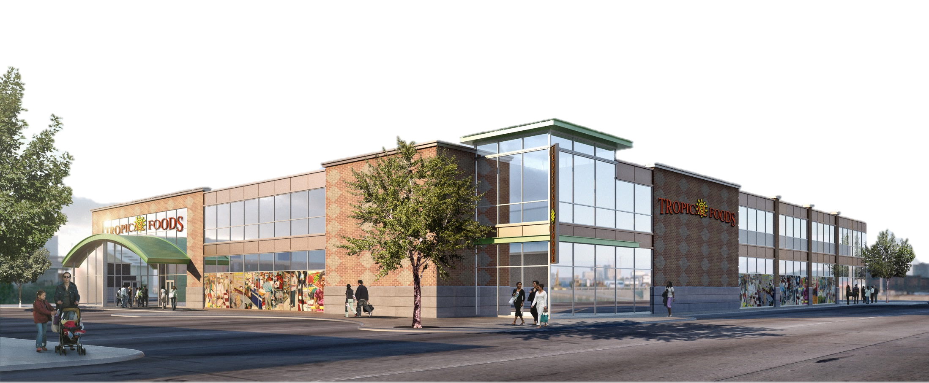

What is the CED Program?
A federal grant program focused on reducing poverty, and the only federal program with a primary focus on creating jobs for individuals with low income in communities with high rates of unemployment and poverty
Grants to private, non-profit CDCs to create or expand businesses, resulting in creation of new jobs
3

Slide 35
What is a CDC?
To be a qualified Community Development Corporation (CDC), an organization must meet three conditions:
  The organization must be a private nonprofit with 501(c)(3) status;
  The organization must have articles of incorporation or bylaws demonstrating that the CDC has a principal purpose of planning, developing, or managing low-income housing or community development projects; and
  The Board of Directors of the organization must have representation from community residents, business leaders, and civic leaders.
3

Slide 36

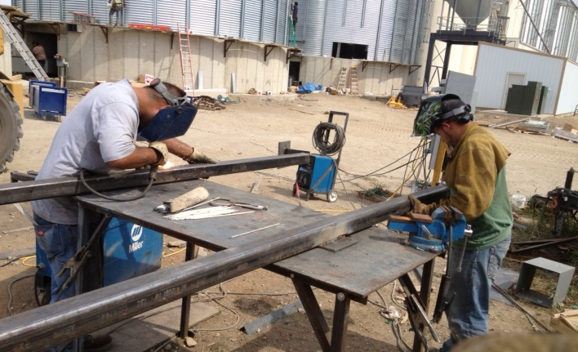
For All CED Projects…
75% of the jobs created are filled by individuals with low income
Focus on creating high-quality jobs that provide living wages, paid leave, fringe benefits, opportunities for career growth, and/or predictable and flexible scheduling
Connect employees to critical wraparound support services
3

Slide 37
Eligible Activities & Strategies
CED projects may utilize multiple strategies, as consistent with 45 CFR Part 75 Subpart E:
  Start-up capital for operating expenses (salaries, facilities, equipment)
  Loans to identified, viable businesses
  Equity investments in identified, viable businesses
  Construction or renovation of new or existing businesses
37

Slide 38
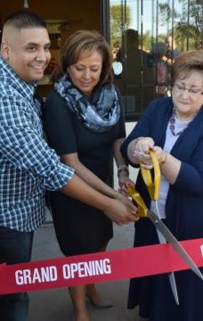
CED Grant Awards
Grants awarded for projects that:
  Develop new products, services, and other commercial activities
  Enhance job creation & business development for individuals with low-income
  Attract additional public and private funds to increase investment
Projects include commercial kitchens, manufacturing businesses, shopping centers, grocery stores, distribution centers, restaurants, farmer’s markers, agricultural initiatives, business incubators, social enterprises, and more.
38

Slide 39
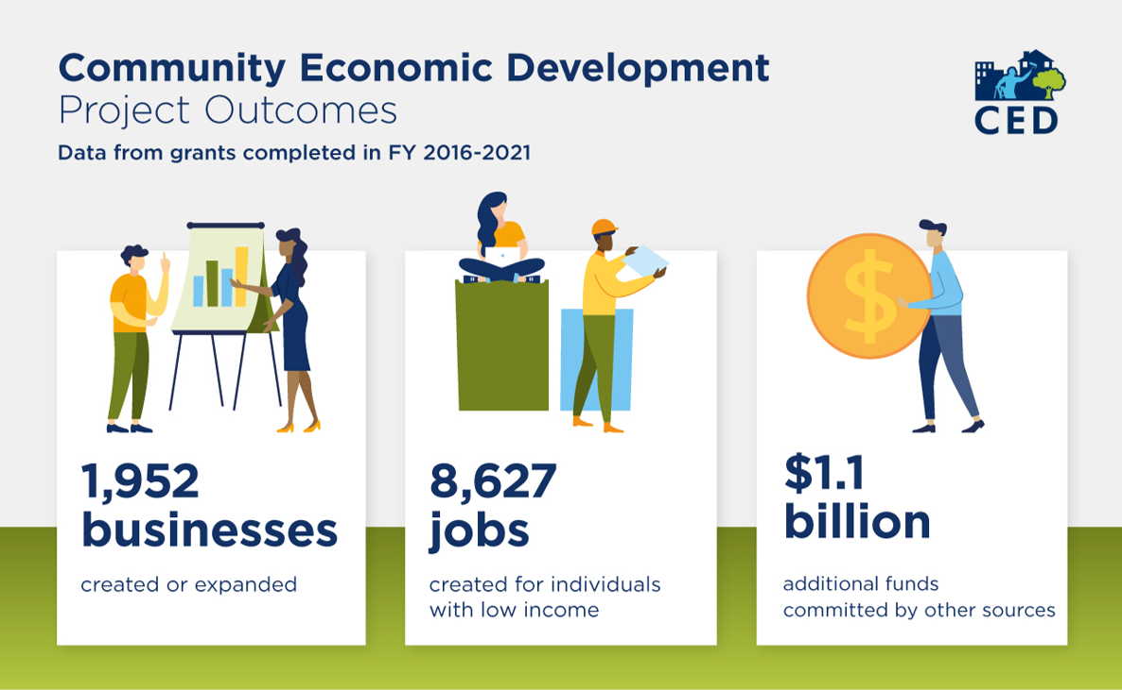
3

Slide 40
How can the CED Program & CDFIs Collaborate?
Leverage CED and CDFI funds together to have a bigger impact in bringing capital to underserved communities.
Benefit from the similar, mission-driven approaches to community development between CED grantees and CDFIs to foster partnership in underserved communities.
Expand financial products and credit services being provided and/or providing services.
Explore parentships to assist new CDFI organizations in becoming a certified CDFI through CDFI Technical Assistance funds.
40

Slide 41
Funding Opportunities in FY 2023
Community Economic Development Projects
(HHS-2021-ACF OCS-EE_1965)
Community Economic Development Focus on Energy Communities (HHS-2022-ACF-OCS-EE-0081)
Community Economic Development Planning Grants
(HHS-2023-ACF-OCS-EE-0056)
  Access opportunities and forecasts on Grants.gov (search by CFDA number: 93.570) or on the CED Website (https://www.acf.hhs.gov/ocs/outreach-material/ced-announcement-apply-ced-grant)
41

Slide 42
2023 CED Projects
CED HHS_2021_ACF OCS-EE_1965
Applications due May 8, 2023
Awards made by September 30, 2023
Funding estimates:
  Estimated Funding Available: $12,300,000
  Expected Number of Awards: 15
  Award Ceiling: $800,000
  Award Floor: $100,000
42

Slide 43
2023 CED Focus on Energy Communities
HHS-2022-ACF-OCS-EE-0081
CED projects that will be located in and serve energy communities
Applications due May 17, 2023
Awards made by September 30, 2023
Funding estimates:
  Estimated Funding Available: $3,200,000
  Expected Number of Awards: 4
  Award Ceiling: $800,000
  Award Floor: $100,000
43

Slide 44
2023 CED Planning Grants
HHS-2023-ACF-OCS-EE-0056
Grants for CDCs to plan and develop CED projects
NOFO release expected Spring 2023
Awards made by September 30, 2023
Funding estimates:
  Estimated Funding Available: $1,500,000
  Expected Number of Awards: 10
  Award Ceiling: $150,000
  Award Floor: $75,000
44

Slide 45
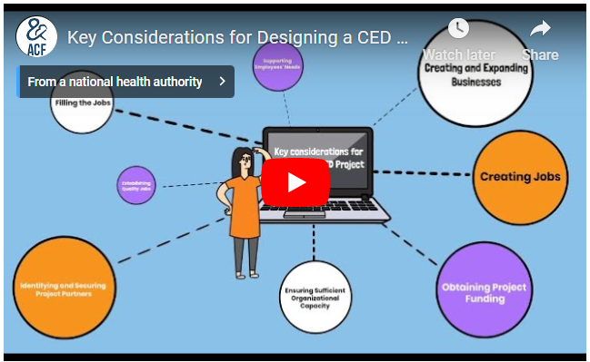
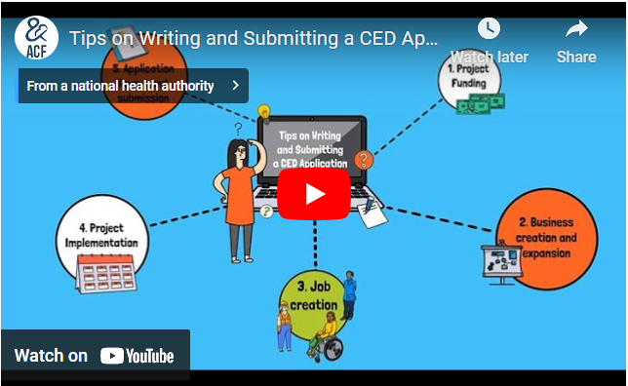
Project Creation & Application Resources
Videos available here! https://www.acf.hhs.gov/ocs/outreach-material/ced-announcement-apply-ced-grant
Key Considerations for Designing a
CED Project
45
Tips on Writing and Submitting a CED Application

Slide 46

Resources
CED Website:
  www.acf.hhs.gov/programs/ocs/programs/ced
Funding Announcements:
  www.acf.hhs.gov/grants
  Questions:
    Lynda.Perez@acf.hhs.gov
    OCSRegistrar@icf.com
46

